Slide 1


CISW 400 (Online) – Client-side Scripting for the Internet
PRESENTATION 1b:
Introduction to
JavaScript
Cosumnes River College
Fishman – 2020
CISW 400 - CRC Fishman 2019 / 2020

Slide 2
Intro to JavaScript
Definition & History
Uses of JavaScript
How it works
CISW 400 - CRC Fishman 2019 / 2020

Slide 3
JavaScript
Definition:
JavaScript is a client-side scripting language built directly into the browser to work with HTML.
What is JavaScript?
An Interpreted programming language for Web browsers.
Code that is embedded within your HTML document.
JavaScript is NOT Java.
A tool for enhancing your web pages.
CISW 400 - CRC Fishman 2019 / 2020

Slide 4

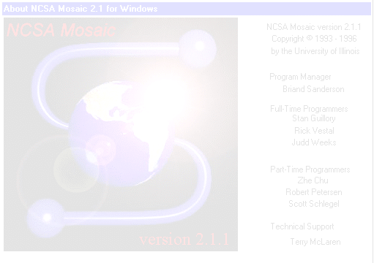
History of JavaScript
1993
1995
1996
1997
1998
2002
DHTML
MSIE 4
Mozilla
Mosaic
LiveScript
JavaScript
JavaScript was introduced by Netscape in the mid-90's. Since then, numerous versions have emerged, improving the ability for web developers to control and manipulate objects on their pages.
CISW 400 - CRC Fishman 2019 / 2020

Slide 5
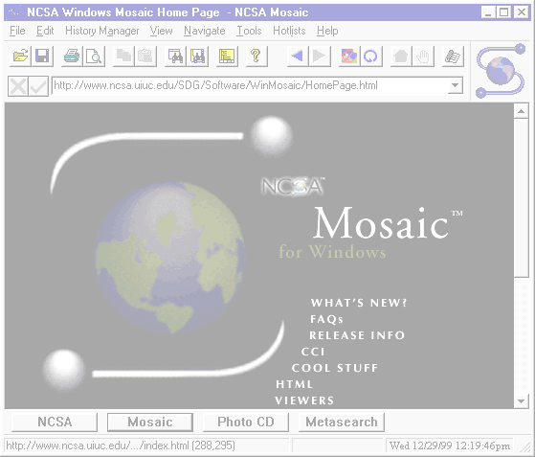


History of JavaScript
1993
NCSA Mosaic Browser, the first web browser was released by a group which later became Netscape.
1995
LiveScript was developed by programmer Brendan Eich. Originally called LiveWire, it was renamed "JavaScript".
LiveScript was renamed JavaScript because its core syntax resembled Sun's Java programming language, released around the same time.
CISW 400 - CRC Fishman 2019 / 2020

Slide 6

History of JavaScript
1996
Netscape 2.0 was released. This new browser
included JavaScript and DOM level 0.
Netscape passed their JavaScript language to
the European Computer Manufacturers Asssoc-
Iation (ECMA) for standardization.
1997
With the release of Netscape 4, Netscape com-
bined JavaScript 1.2 with the new W3C CSS
recommendation, to produce Dynamic HTML.
The W3C is an international industry consortium founded in 1994 for the devel-opment of common standards for the World Wide Web.
CISW 400 - CRC Fishman 2019 / 2020

Slide 7
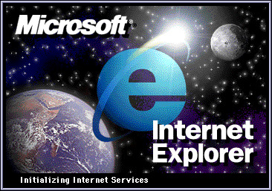
History of JavaScript
1998
Microsoft released Internet Explorer 4 browser.
Included modifications to the DOM.
1999
Microsoft released IE 5, which supported Java-
Script 1.4, ECMAscript, and Jscript.
With Netscape and MSIE versions 4, the browser market momentum swung towards Microsoft. Microsoft has dominated the market since then, but in recent years, other vendors are gaining popularity.
CISW 400 - CRC Fishman 2019 / 2020

Slide 8


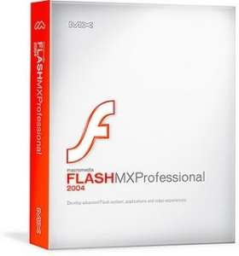
History of JavaScript
2000
Microsoft introduced .NET framework and up-graded ASP to ASP.NET which includes JavaScript as one of the many languages it supports.
2002
Mozilla released open-source Gecko rendering Engine and SpiderMonkey JavaScript engine.
2004
Macromedia Flash MX 2004 introduced ActionScript 2.0, an implementation of the ECMAScript standard.
Recent developments in the browser world, such as the "Gecko rendering engine", indicate a more standardized approach to web programming across industry.
CISW 400 - CRC Fishman 2019 / 2020

Slide 9
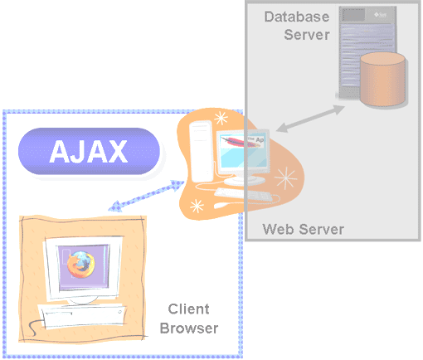
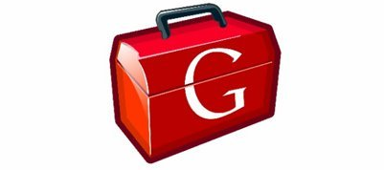
History of JavaScript
2005
AJAX: Emergence of Asynchronous JavaScript and XML. A set of scripting languages used to create browser-based applications
that behave more like software
applications.
2006
JSON Javascript Object Notation, a lightweight text-based open standard designed for human-readable data interchange
CISW 400 - CRC Fishman 2019 / 2020

Slide 10

History of JavaScript
2006
JavaScript 2 development begun at Mozilla Corporation. Possible release date is 2019 / 2020
jQUERY: a cross-browser JavaScript library designed to simplify the client-side scripting
of HTML, released at BarCamp NYC
by John Resig.
2009
The CommonJS project was founded with the goal of specifying a common standard library for JavaScript development outside the browser.
CISW 400 - CRC Fishman 2019 / 2020

Slide 11

History of JavaScript
2009
node.js: an open-source, cross-platform runtime environment for developing server-side web applications written in JavaScript
AngularJS: open-source web application framework used for developing and testing single-page applications
2011
HTML5 & CSS3
CISW 400 - CRC Fishman 2019 / 2020

Slide 12
Intro to JavaScript
Definition & History
Uses of JavaScript
How it works
CISW 400 - CRC Fishman 2019 / 2020

Slide 13


What can you do with JavaScript?
Create Image Rollovers
A rollover is a common JavaScript effect used to alternate images
on a web page, without needing to reload from the server.
Click here to see an example of JavaScript rollovers.
CISW 400 - CRC Fishman 2019 / 2020

Slide 14
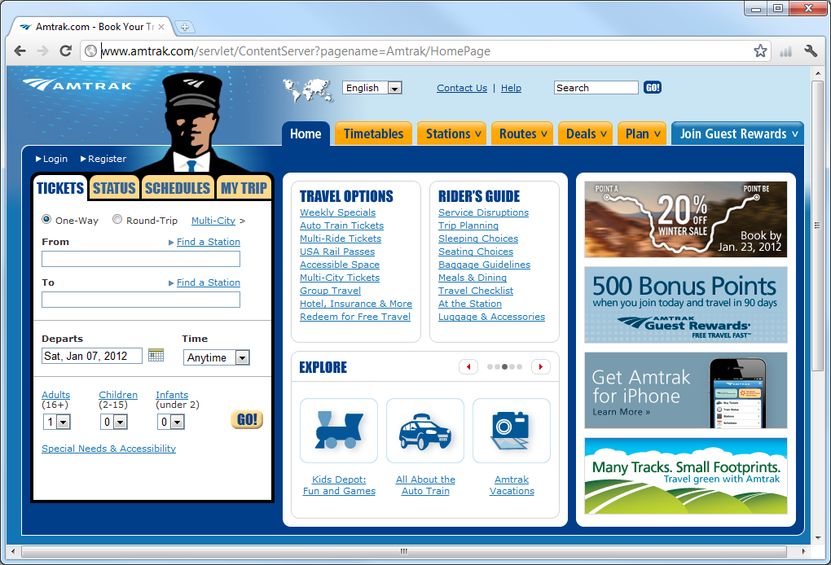
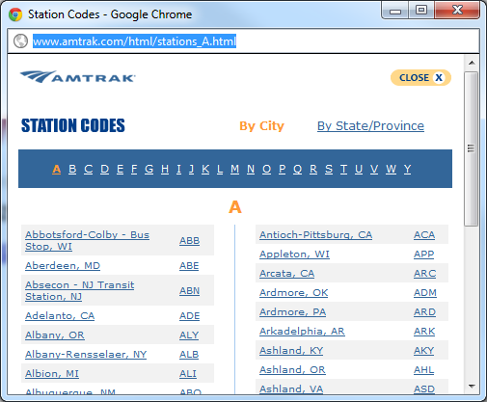
What can you do with JavaScript?
Create Pop-up Windows
JavaScript enables you to create new browser windows and control
their properties such as size, location, and lifespan.
CISW 400 - CRC Fishman 2019 / 2020

Slide 15
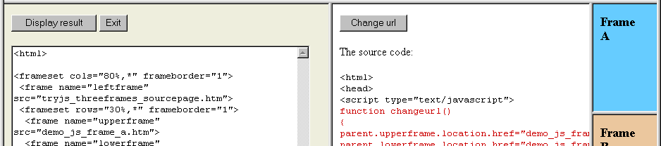
What can you do with JavaScript?
Control Frames & Forms
JavaScript gives the web programmer enhanced control over HTML
frames and forms. With JavaScript, you could open multiple frames
from a single link, or validate user credit card information.
CISW 400 - CRC Fishman 2019 / 2020

Slide 16




What can you do with JavaScript?
Create Web Banners
Banners that rotate and cycle, are typically created in JavaScript.
Click to see example of JavaScript Rotating Images
CISW 400 - CRC Fishman 2019 / 2020

Slide 17
What can you do with JavaScript?
Last Modified Date
Browser Detection
Bake Cookies
and much more ...
In general, JavaScript gives the programmer better control over the browser and the web environment. It enables you to improve the functionality of your web page, and do things like detect the type of browser a client is using or write a "cookie" file to the clients machine.
CISW 400 - CRC Fishman 2019 / 2020

Slide 18
Intro to JavaScript
Definition & History
Uses of JavaScript
How it works
CISW 400 - CRC Fishman 2019 / 2020

Slide 19
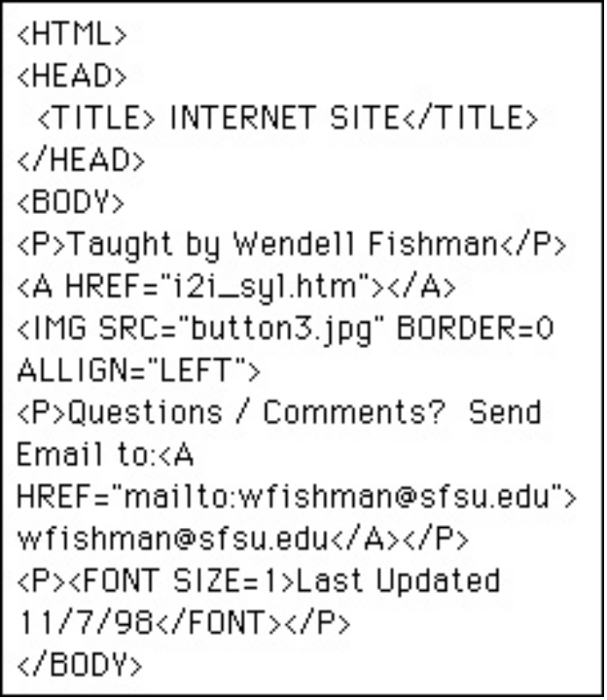

How does it work?
You can type JavaScript directly inside of your HTML code. Using a set of special HTML tags, it is possible to embed other languages within the HTML document. Then, when the browser interprets your HTML code, it will interpret the embedded JavaScript as well.
HTML
Embedded code
JavaScript
Since JavaScript interacts with the browser while the user is surfing, it is considered to be a client-side language. This also means it is faster.
CISW 400 - CRC Fishman 2019 / 2020

Slide 20
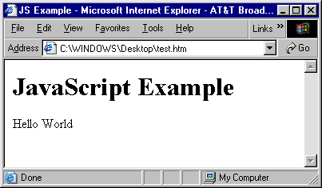
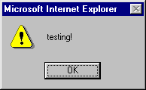
How does it work?
HTML uses the <SCRIPT> tag and the LANGUAGE attribute to enable other types of code to be used on a web page.
Embedded
code
<HTML>
<HEAD><TITLE>JS Example</TITLE></HEAD>
<BODY>
<H1>JavaScript Example</H1>
<SCRIPT LANGUAGE="JavaScript">
document.write('Hello World');
alert('testing!');
</SCRIPT>
</BODY>
</HTML>
CISW 400 - CRC Fishman 2019 / 2020

Slide 21
Example 1: Hello World
This example illustrates the classic Hello World program in JavaScript,
which means it simply writes "Hello World" to the web page.
<script language="JavaScript">
document.write('Hello World');
</script>
Syntax
JavaScript takes us one step closer to computer programming.
Therefore, more attention must be paid to proper syntax. Note, that
you must end each line (with a few exceptions) with a semi-colon (;).

Slide 22
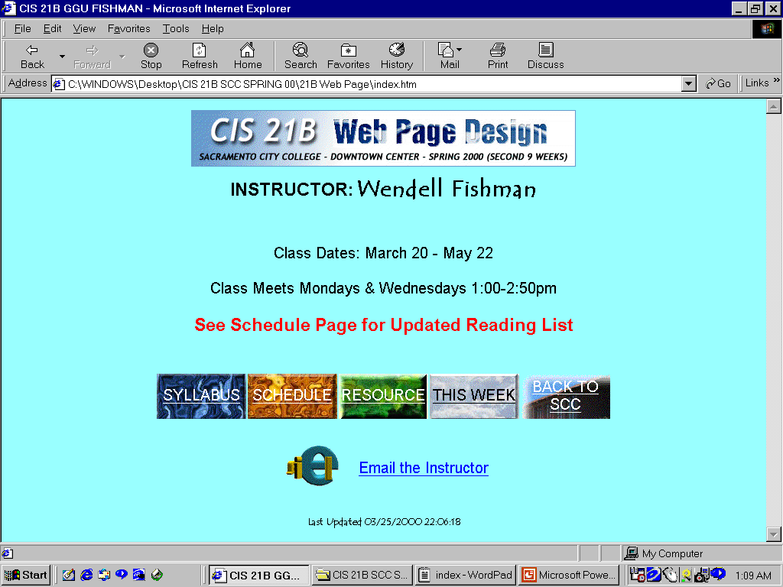
JavaScript Example 2:
This example uses Java-
Script to place a date stamp at the bottom of a web page.
CISW 400 - CRC Fishman 2019 / 2020

Slide 23
JavaScript Example 2:
<HTML>
<HEAD><TITLE>CIS 21B GGU FISHMAN</TITLE></HEAD>
<BODY BGCOLOR="99FFFF">
<CENTER>
<IMG SRC="CIS21BHeader.gif">
<TABLE>
<TR>
<TD><H3><FONT FACE="Arial">INSTRUCTOR: </FONT></H3>
<TD><H2><FONT FACE="Tempus Sans ITC">Wendell Fishman</FONT></H2>
</TABLE>
<P><FONT FACE="Arial">Class Dates: March 20 - May 22</FONT></P>
<P><FONT FACE="Arial">Class Meets Mondays & Wednesdays 1:00-2:50pm</FONT></P>
<H3><FONT FACE="Arial" COLOR="Red"><BLINK>See Schedule Page for Updated Reading List</BLINK></FONT></H3>
<TABLE>
<TR>
<TD><IMG SRC="email_icon.gif">
<TD><A HREF="mailto:fishmaw@crc.losrios.cc.ca.us"><FONT FACE="Arial">Email the Instructor</FONT></A>
</TABLE>
<P><FONT SIZE=1>Last Updated <SCRIPT LANGUAGE="JavaScript">
<!--
document.write(document.lastModified);
// -->
</SCRIPT></FONT></P>
</CENTER>
Viewing the source code reveals the placement of the JavaScript in the HTML document.
Note: This code is enlarged on the following slide.
CISW 400 - CRC Fishman 2019 / 2020

Slide 24
JavaScript Example 2:
Enlarged script code from previous slide.
<p>
Last Updated
<script language="JavaScript">
document.write(document.lastModified);
</script>
</p>
CISW 400 - CRC Fishman 2019 / 2020

Slide 25
Notes:
Date Stamp
This example is similar to the Hello World script, but instead of writing
"Hello World" to the document, it writes the value of a pre-defined
JavaScript variable called "lastModified". As you probably guessed,
"lastModified" contains the date and time that a web page was last
saved by the programmer.
Syntax
Remember, JavaScript is picky about syntax. The lastModified,
variable should be typed with a lower-case "l" and a upper-case "M".
Otherwise, the script may not work.
Script placement
In this example, the script appears at the bottom of the page. Note,
however, that JavaScript code may appear anywhere within an HTML
document - even inside of the <HEAD>.
CISW 400 - CRC Fishman 2019 / 2020

Slide 26
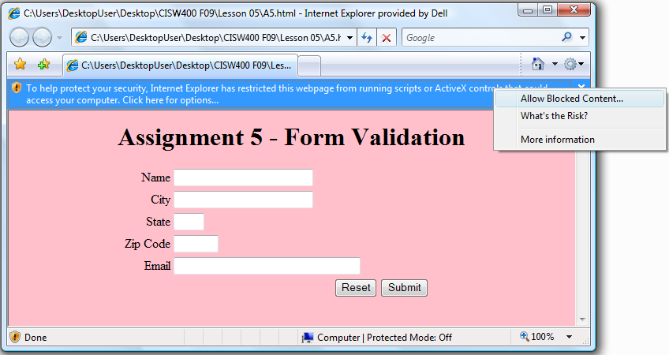

Notes (continued):
Security Blocks
Most Windows Operating systems will attempt to block your JavaScript
code from running, when you try to open your pages locally.
If you get the yellow security bar (MSIE), then click to “Allow Blocked Content”.
Be assured that the scripts for this class are safe and do not pose a
security threat to your browser or computer.
CISW 400 - CRC Fishman 2019 / 2020

Slide 27
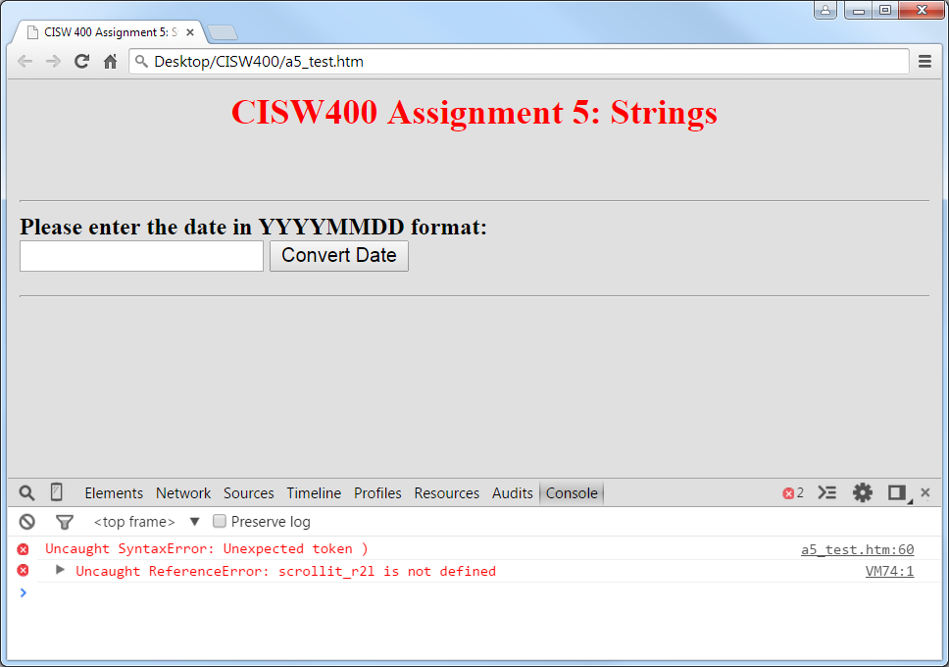
Notes (continued):
Debugging
If your script is not working, try pressing the F12 key, while viewing it in the browser. F12 brings up the Console, allowing you to debug the code.
If there are errors, they will be displayed under the Console tab.
F12 works in MSIE, Firefox, and Chrome browsers.

Slide 28

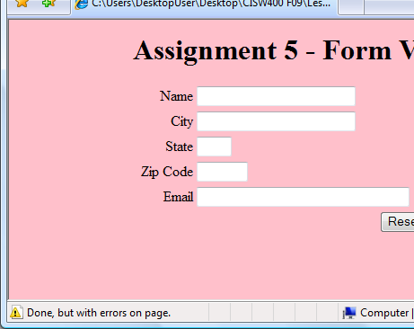
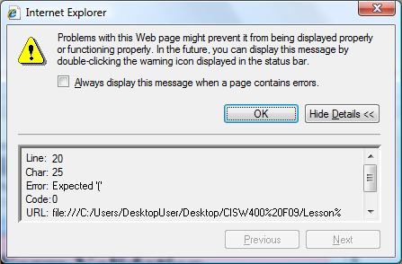
Notes (continued):
Debugging
In older browsers, if your script has errors, you can click on the Yellow Error Alert icon that appears in the lower-left corner of the browser.
Click to Show Details and often, it will tell you on what line the error is occurring.

